Slide 1
Data Analysis
SwissFEL 2019 Prep

Slide 2
Prerequisites
RA cluster account
GitHub account
Download Anaconda onto your personal computer

Slide 3
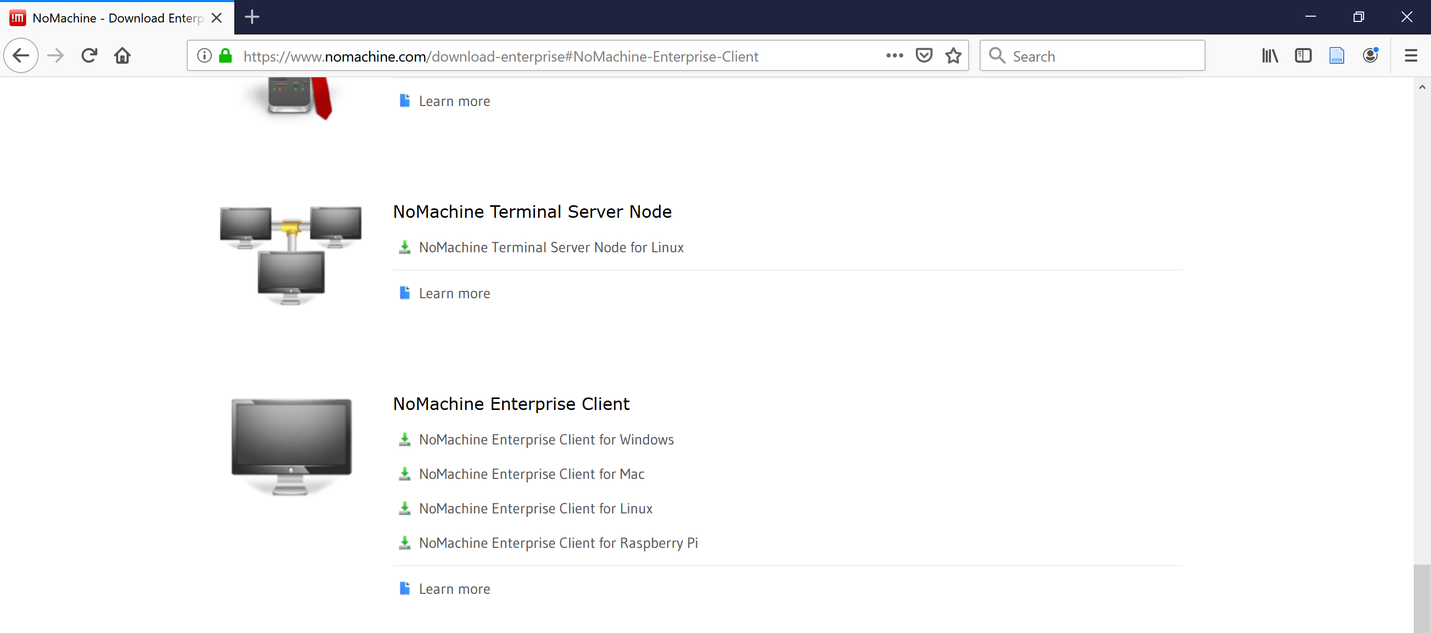
Install NoMachine

Slide 4
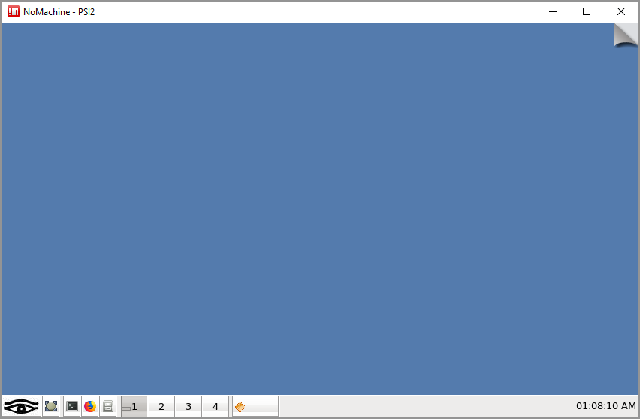
Set up NoMachine
https://www.psi.ch/en/photon-science-data-services/remote-interactive-access

Slide 5
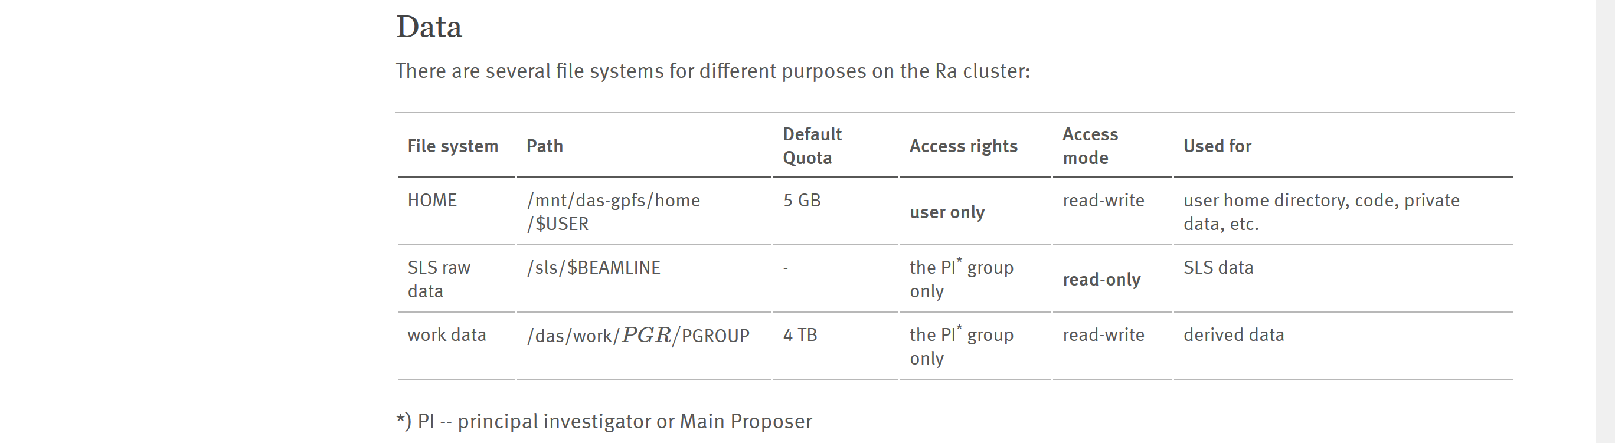
Where things are

Slide 6
First thing to do
Run the following command:
/sf/alvra/config/setup/setup.sh p17983

Slide 7
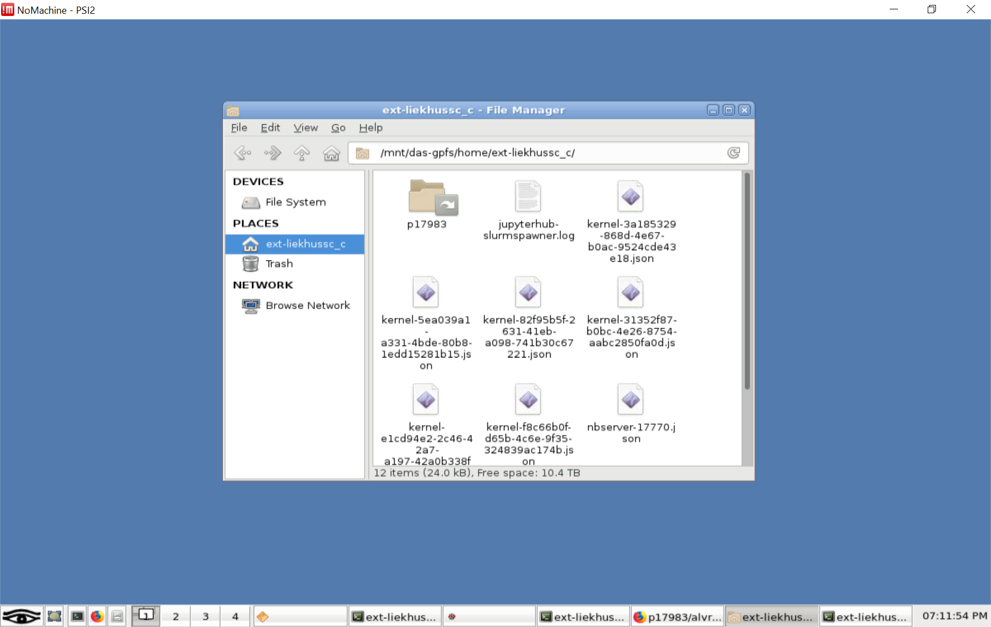
File Locations

Slide 8
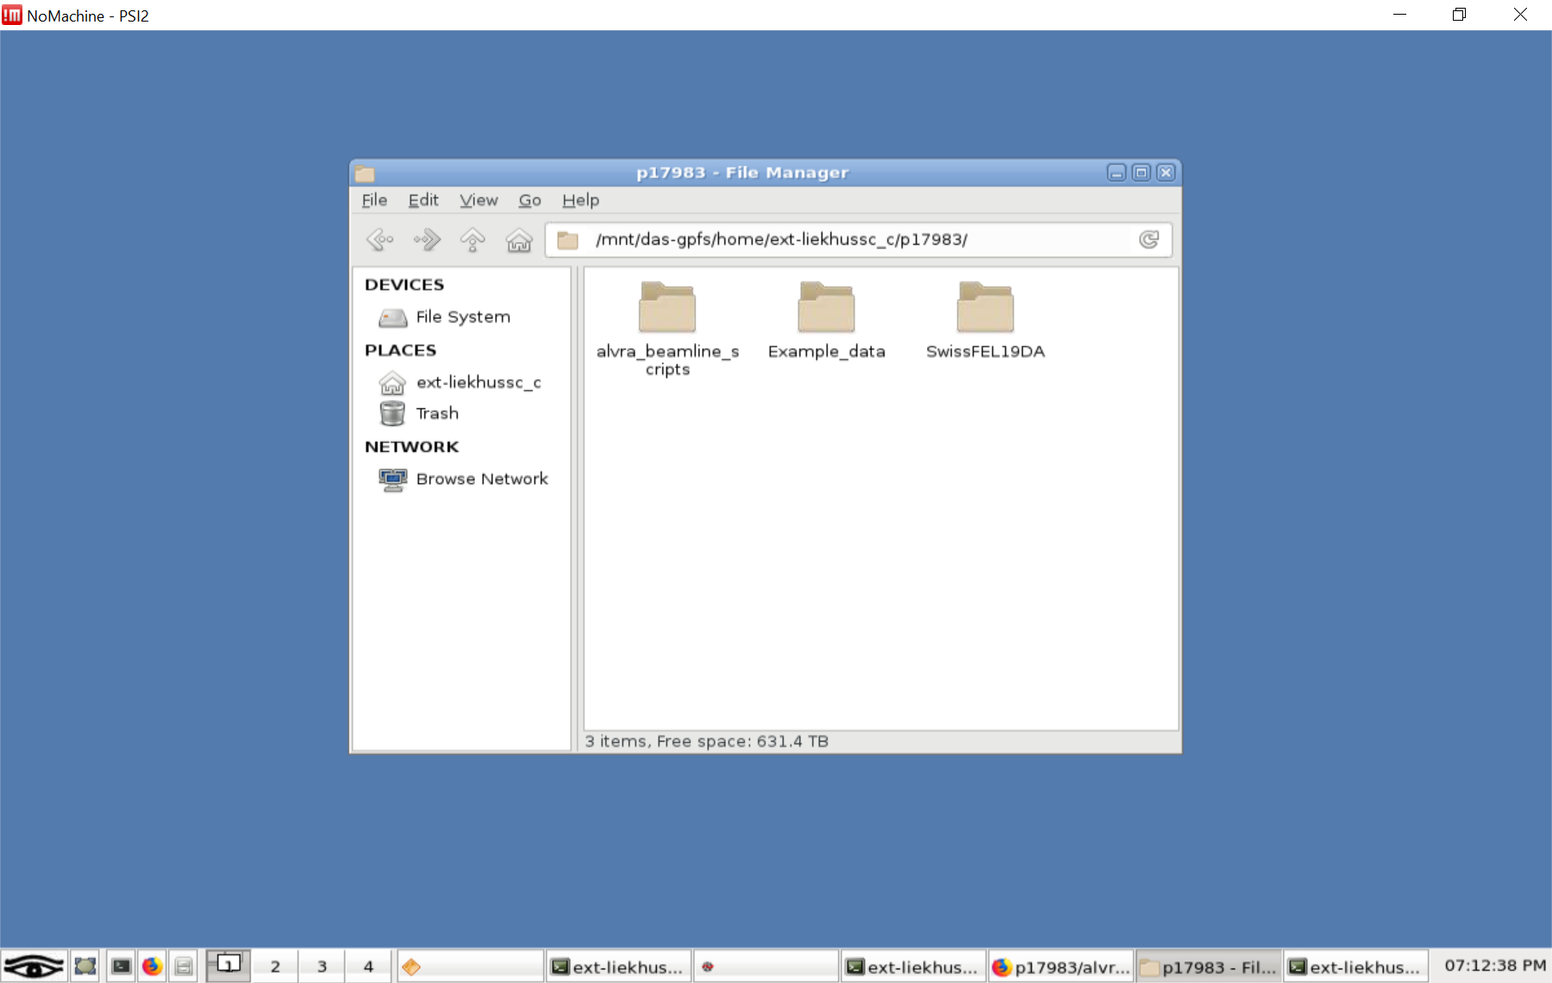
File locations
Scripts written by us
Scripts written by the beamline

Slide 9
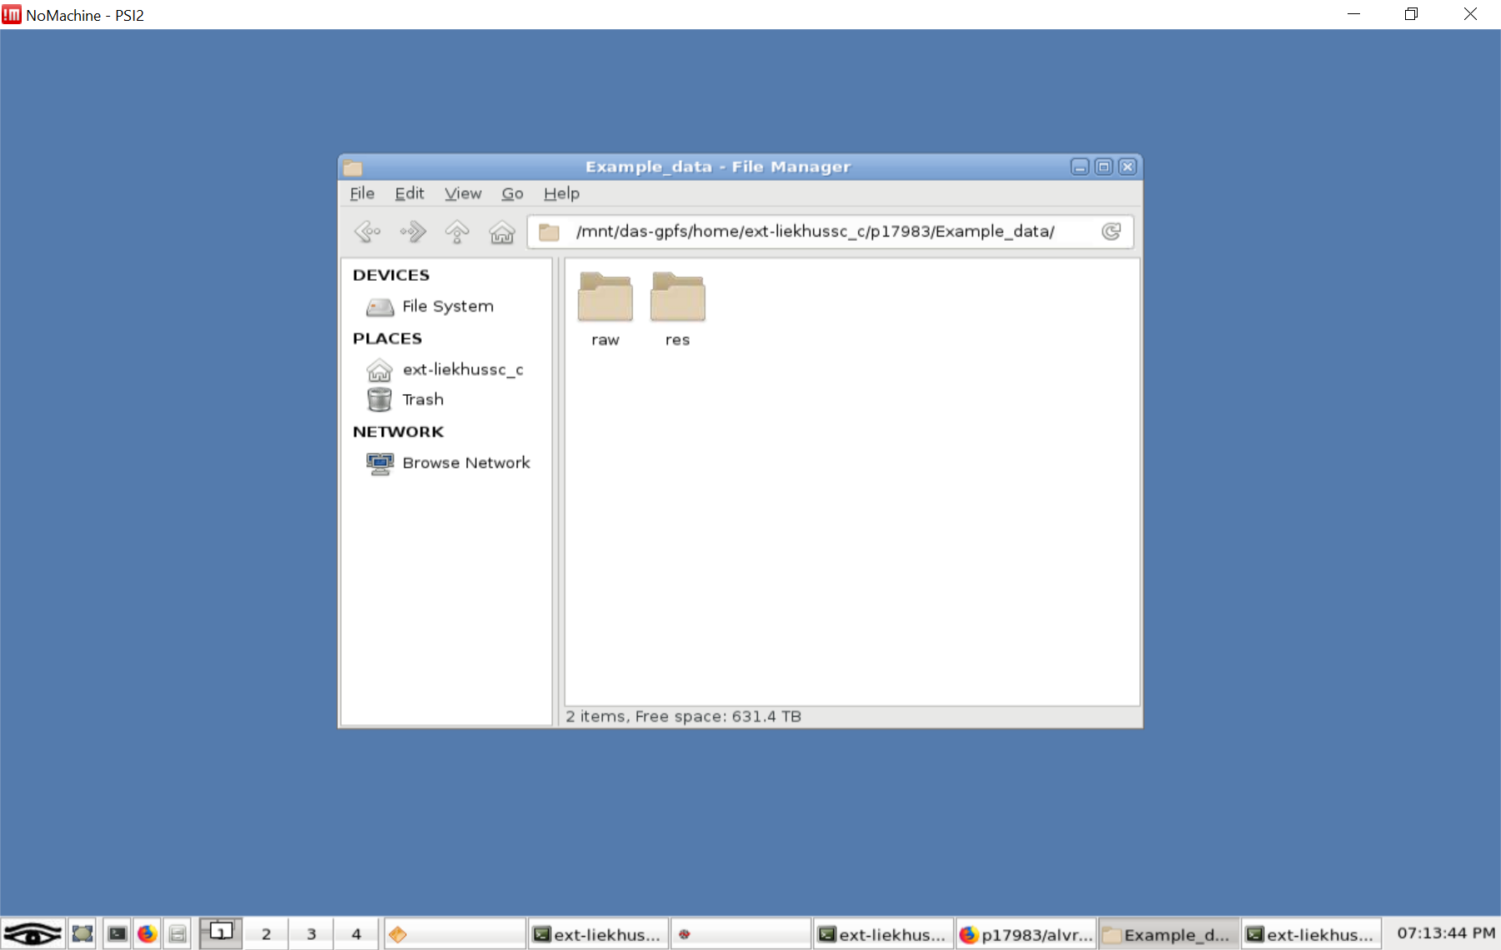
File locations
Res data is where the scan info is
Raw data is where the sensor readings are

Slide 10
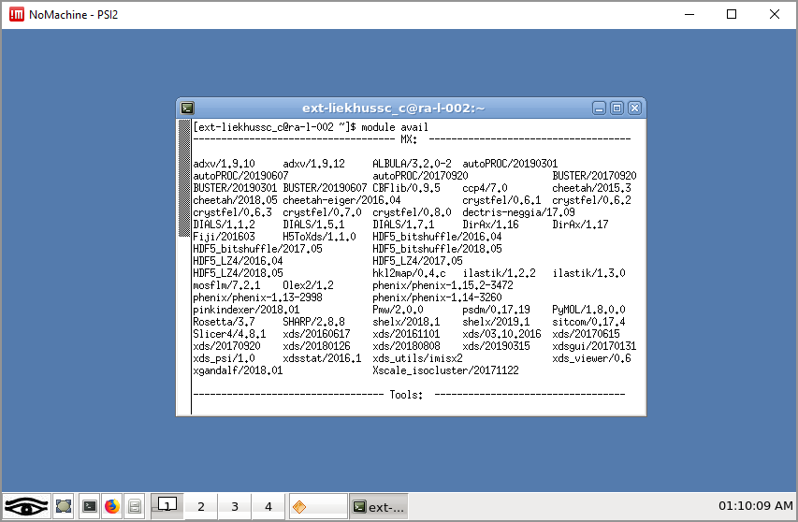
Setting up python

Slide 11
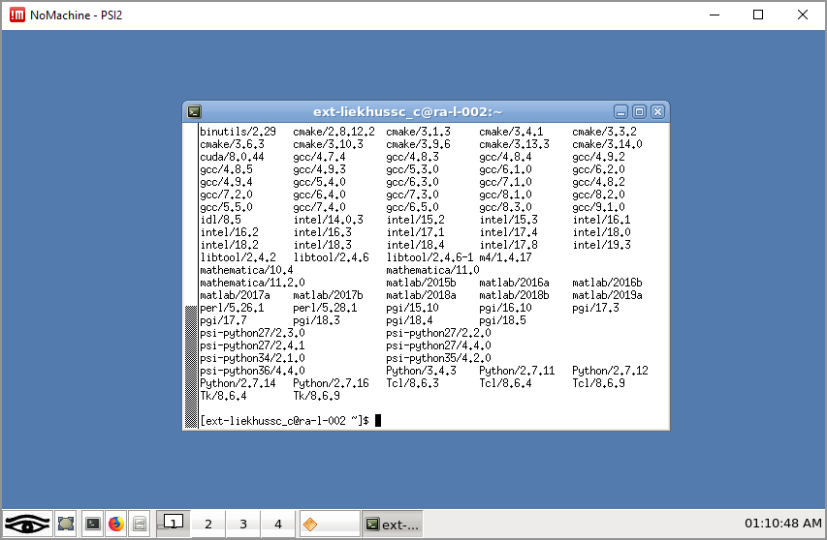
Setting up python

Slide 12
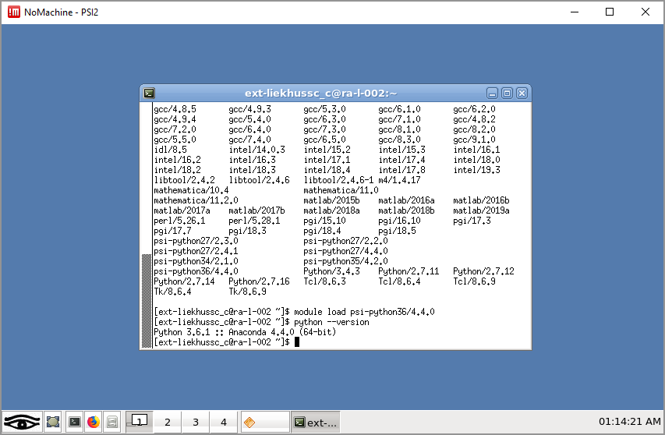
Setting up python

Slide 13
Log into jupytera while at the beamline
Go to the site https://jupytera.psi.ch in firefox
Log in and work on the notebooks from here
You should do this for the work we do at the beamline
The next page is just another way to do this if you’re doing local things, or if you want to make sure jupyter notebook is set up properly.

Slide 14
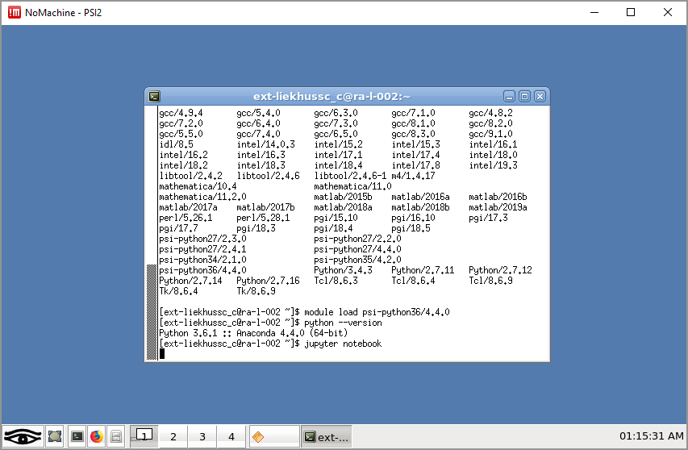
Starting a Jupyter Notebook – in general

Slide 15
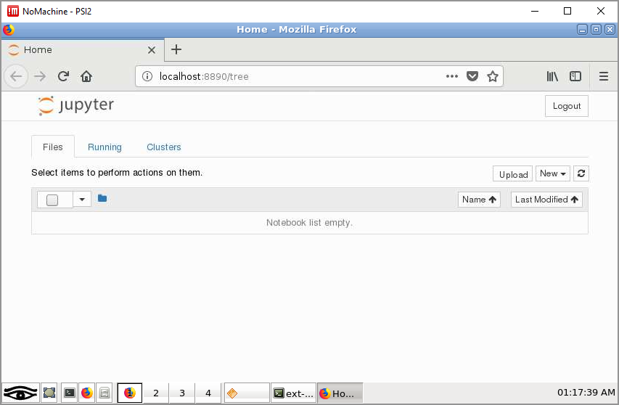
Starting Jupyter Notebook

Slide 16
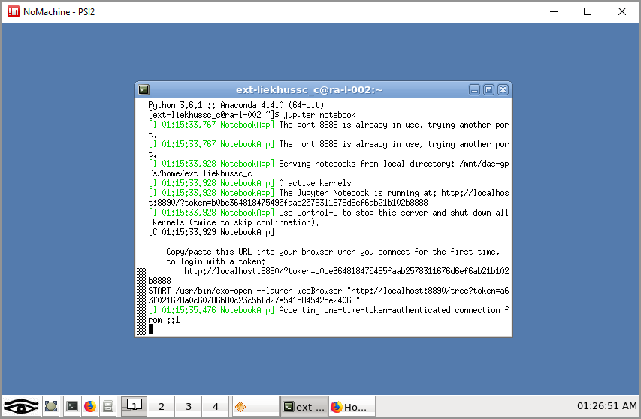
Closing Jupyter Notebook

Slide 17
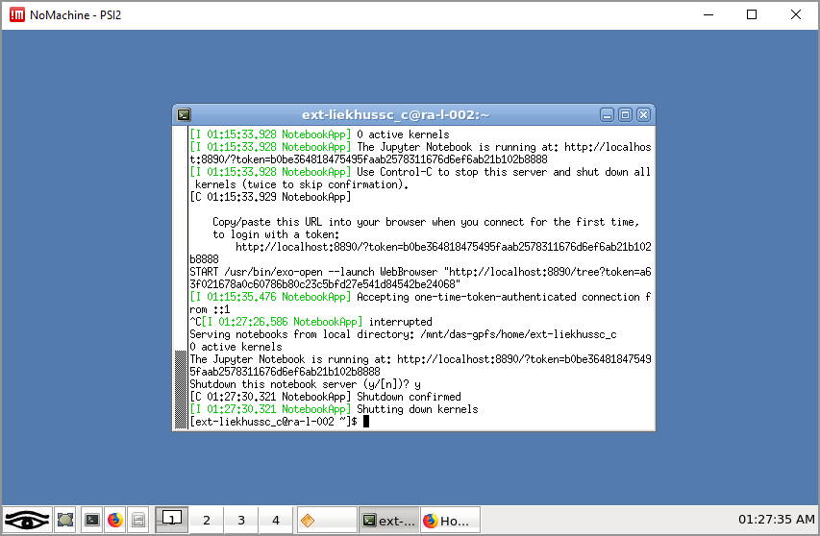
Closing Jupyter Notebook

Slide 18
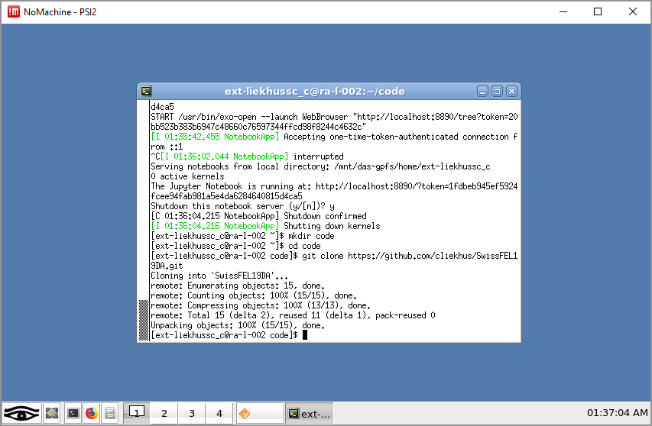
Connect to GITHUB

Slide 19
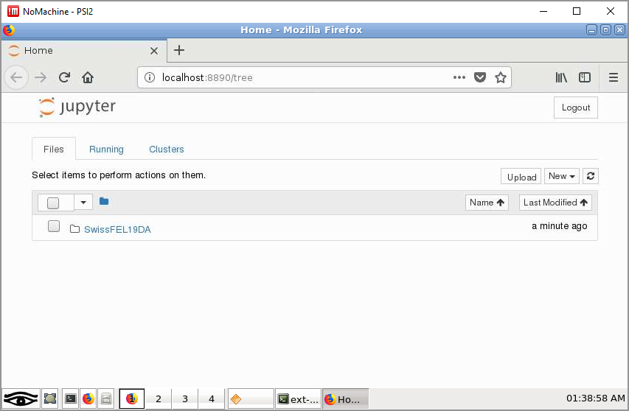
Using Jupyter Notebook

Slide 20
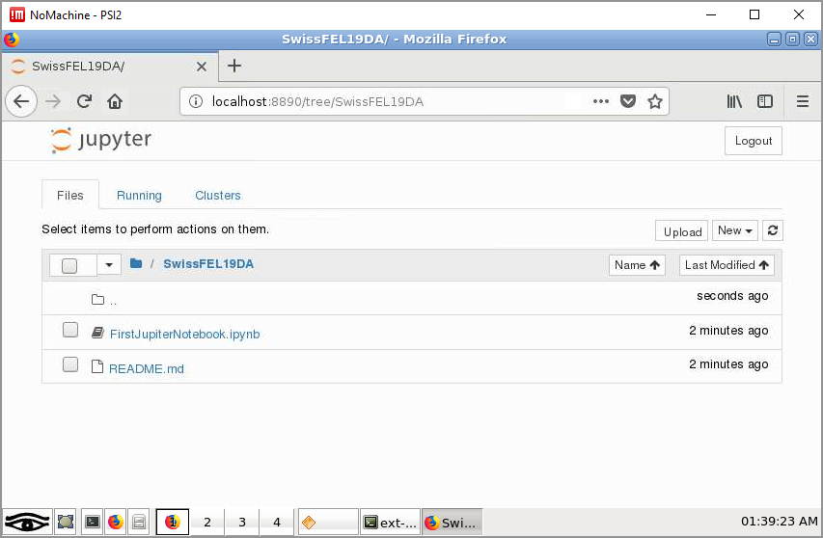
Using Jupyter Notebook

Slide 21
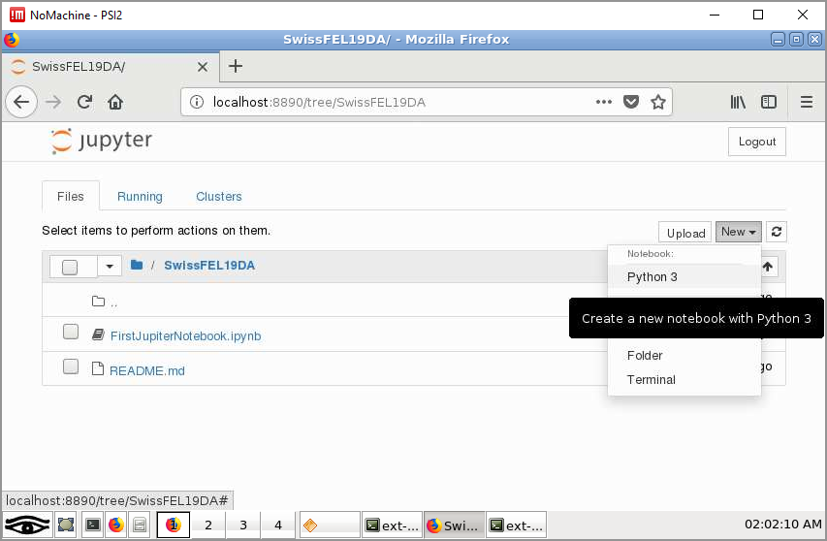
Using Jupyter Notebook

Slide 22
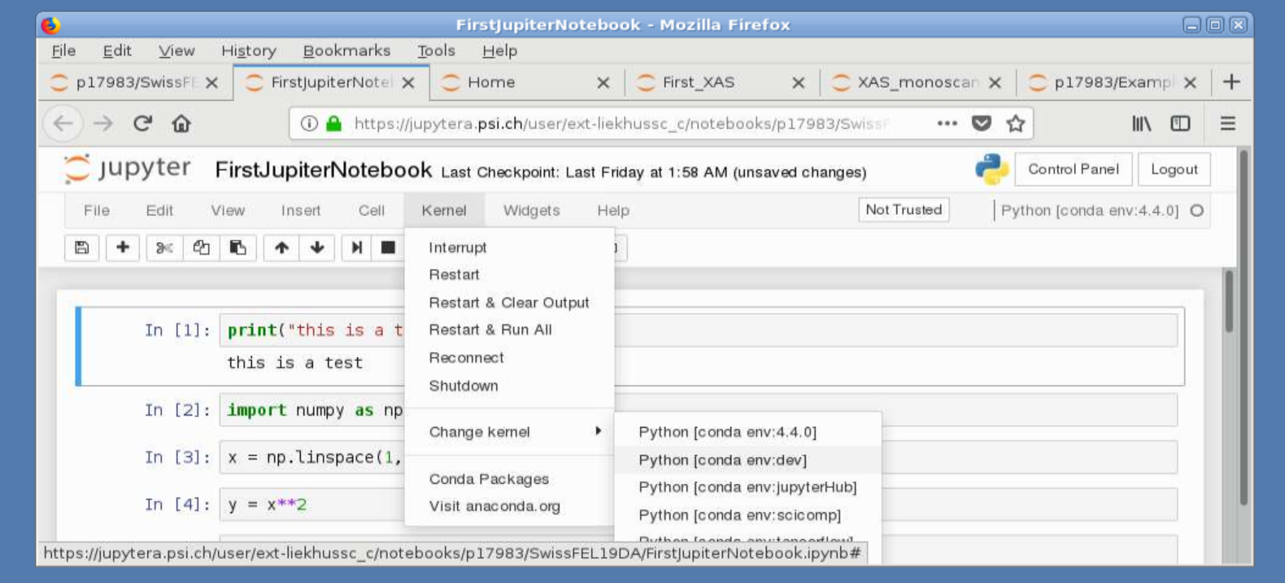
Pick the correct kernel
Pick the “on day allocation”
Choose the [conda env:dev] kernel
https://jupytera.psi.ch

Slide 23
The next slides
The next slides are all using the “regular” jupyter notebook, so don’t be surprised if there are some changes in how the notebooks look. Everything follows, you just needed to do these extra steps in the last slide.

Slide 24
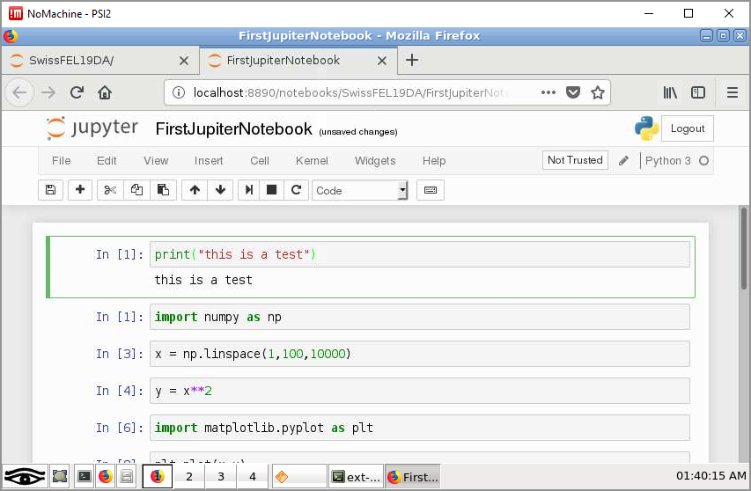
Using Jupyter Notebook
Shift Vs Control Enter

Slide 25
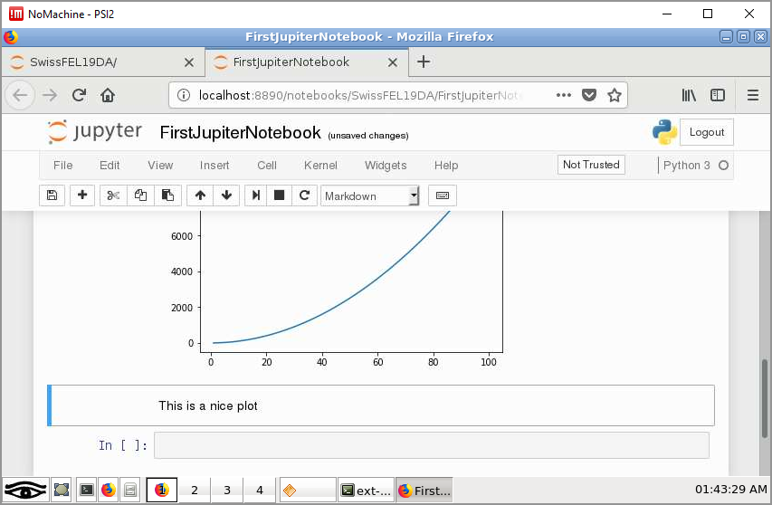
Writing in Jupyter Notebook

Slide 26
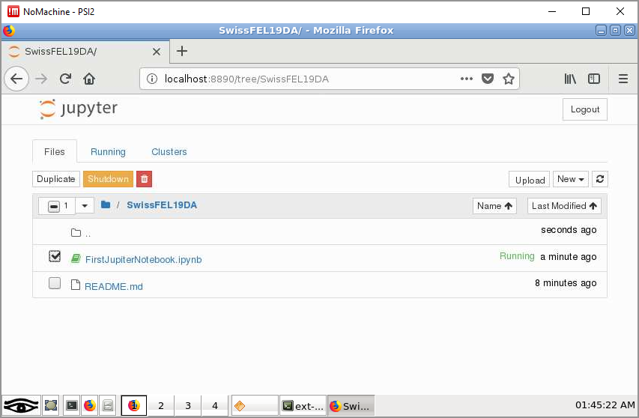
Shutting down a notebook

Slide 27
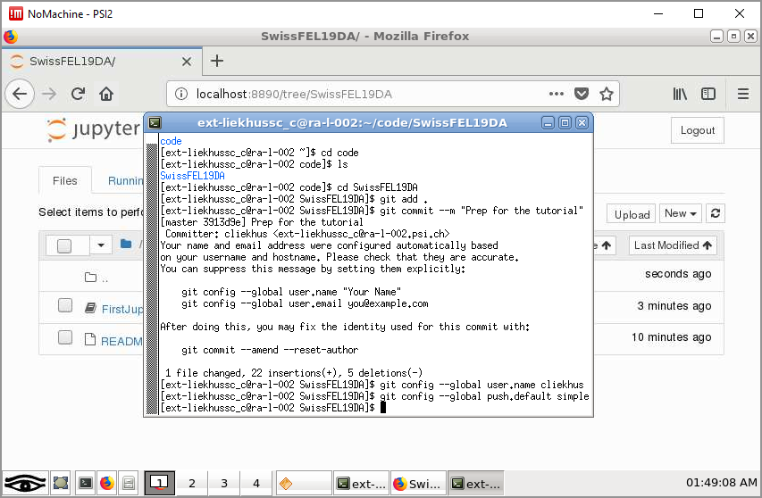
Commit changes

Slide 28
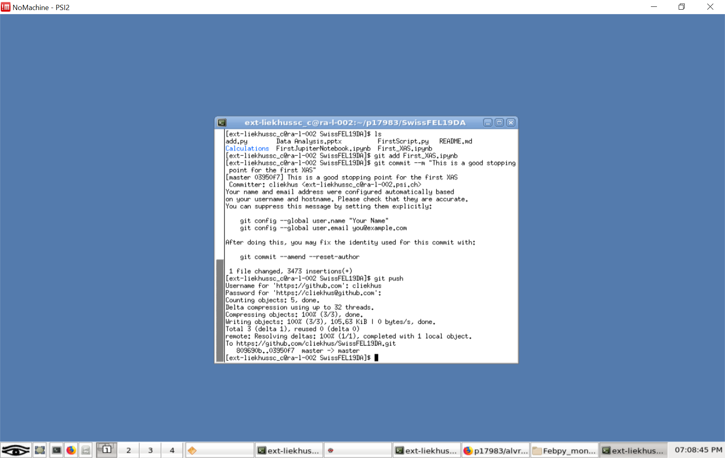
Commit just one file

Slide 29
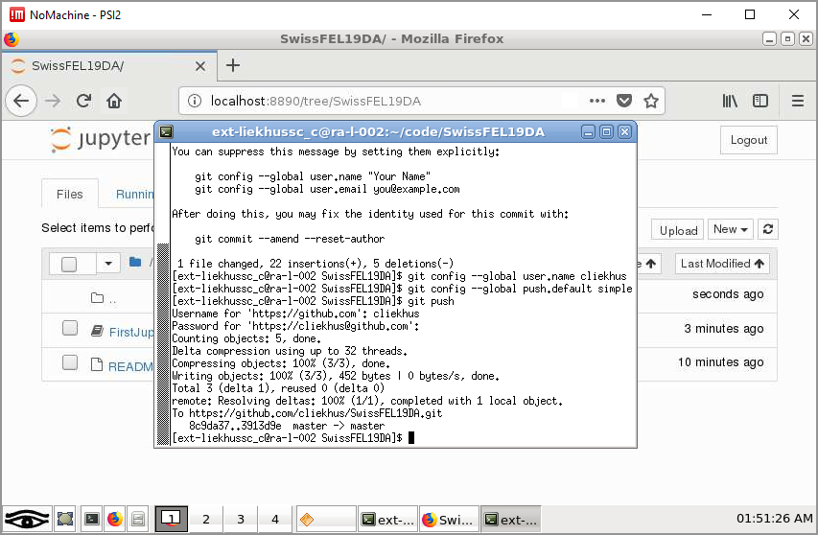
Push changes

Slide 30
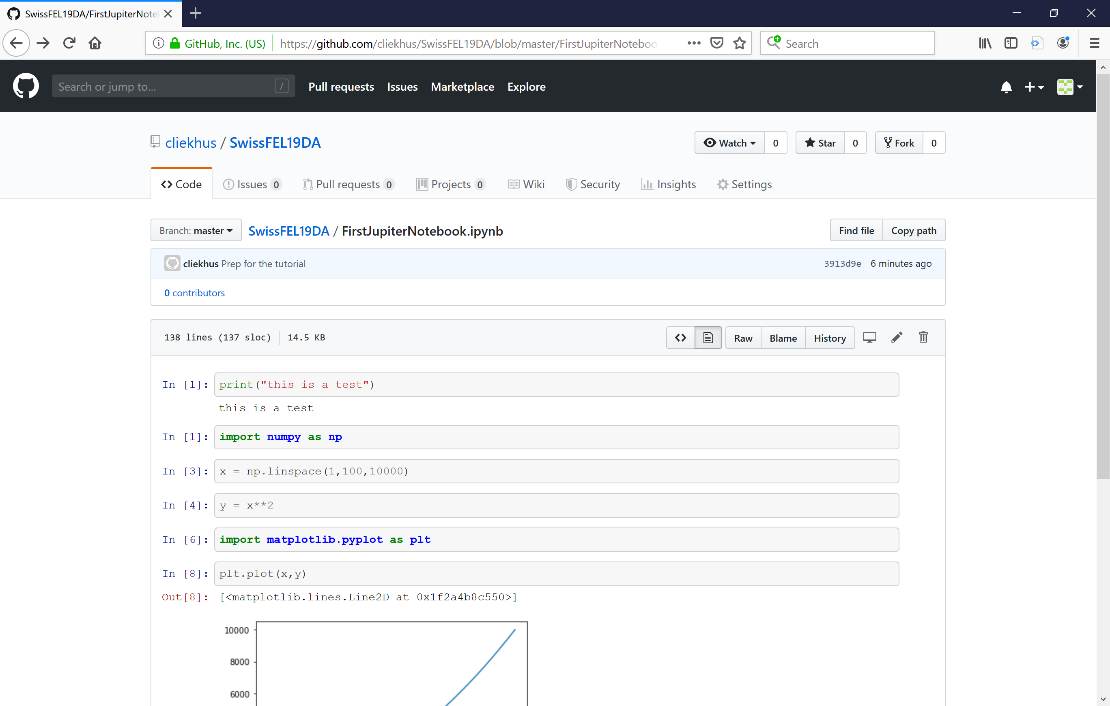

Slide 31
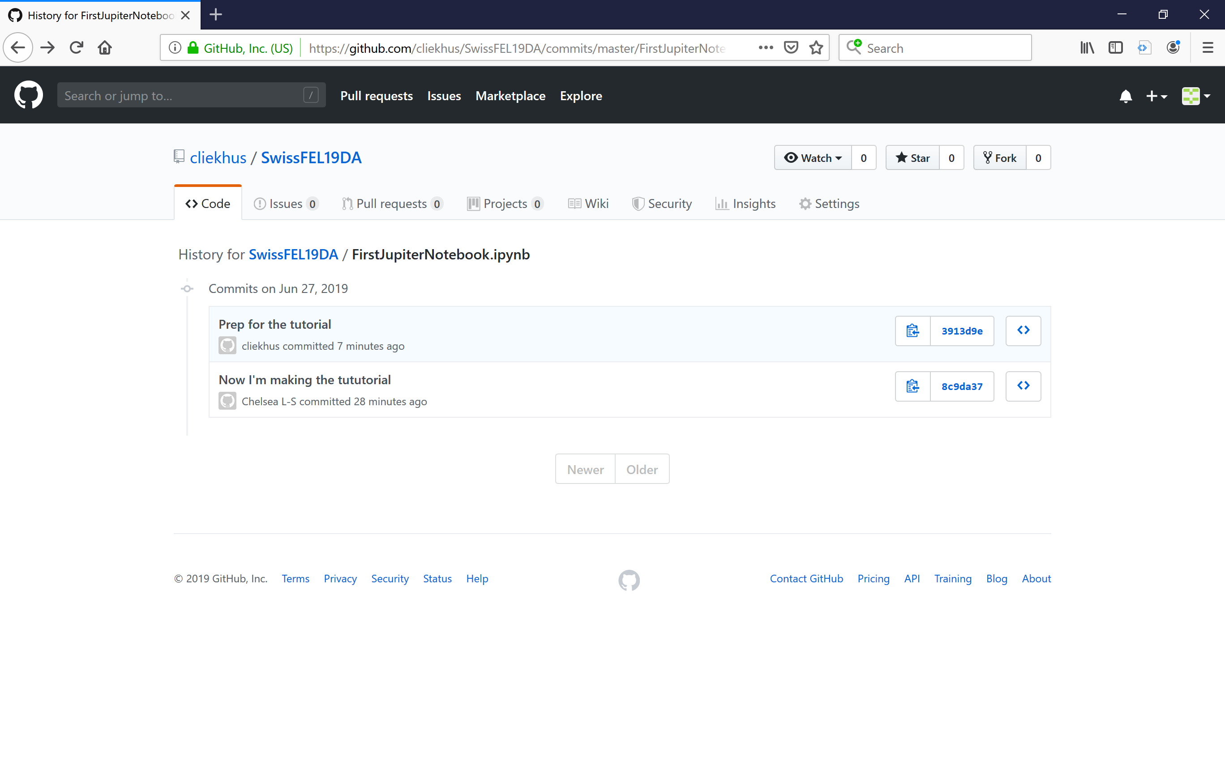

Slide 32
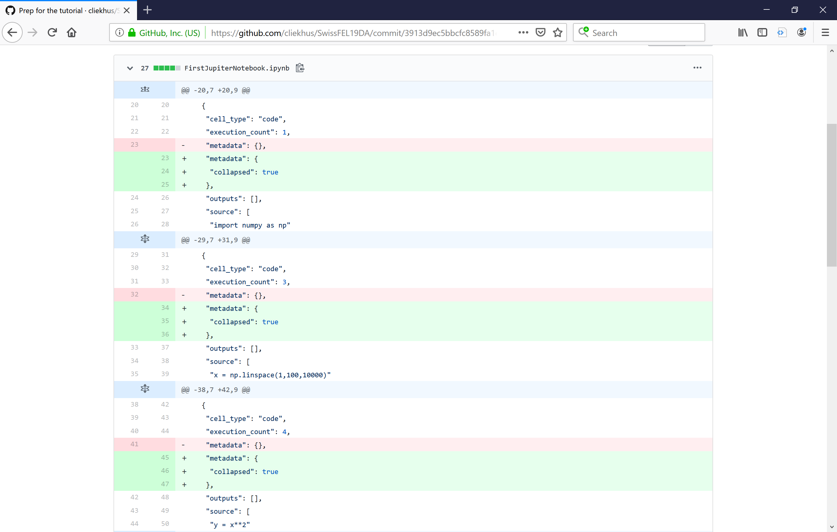

Slide 33
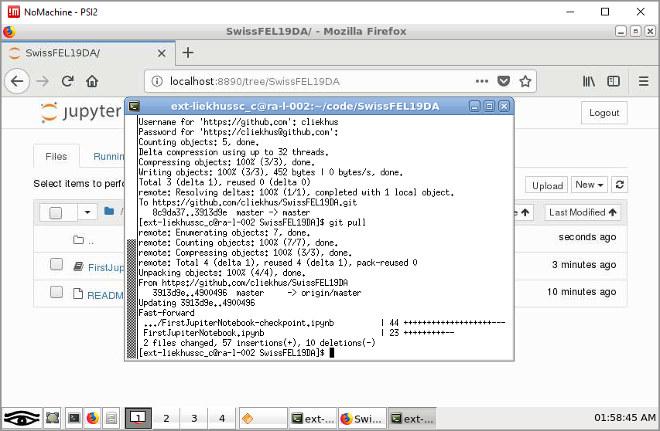
Pull Changes

Slide 34
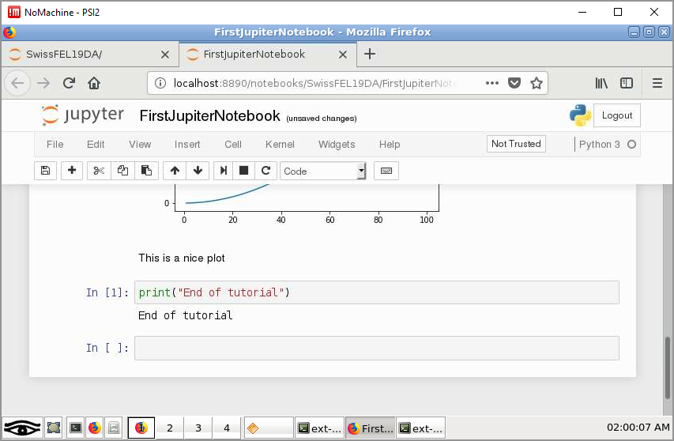
Pull Changes

Slide 35
Other GitHubs
https://github.com/paulscherrerinstitute/alvra_beamline_scripts.git
https://github.com/paulscherrerinstitute/alvra_tools.git
https://github.com/paulscherrerinstitute/jungfrau_utils

Slide 36
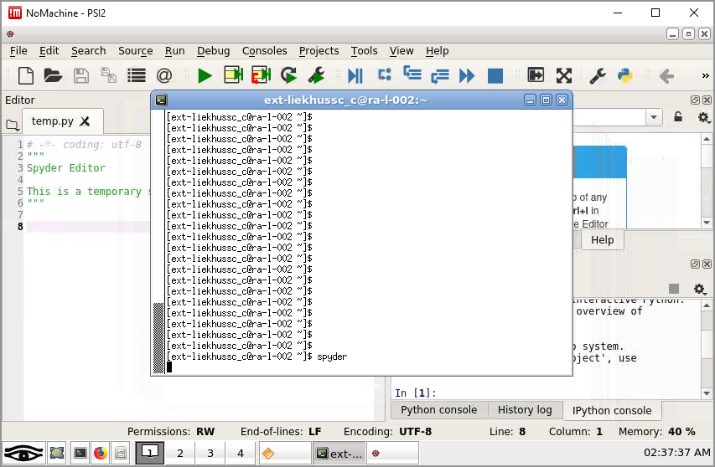
Writing functions – use “spyder”

Slide 37
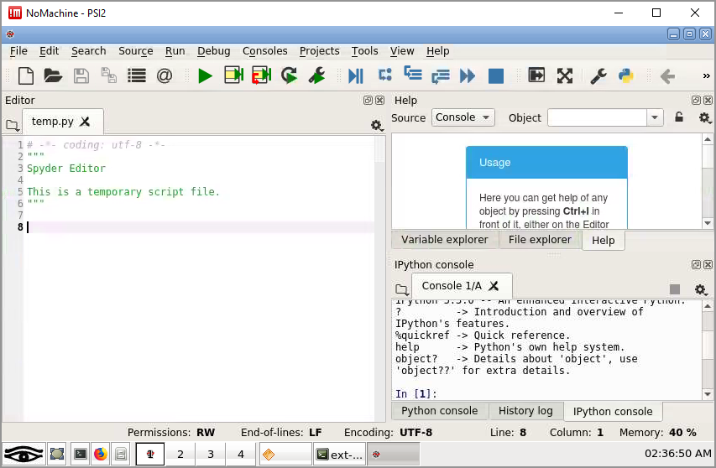
Using Spyder

Slide 38
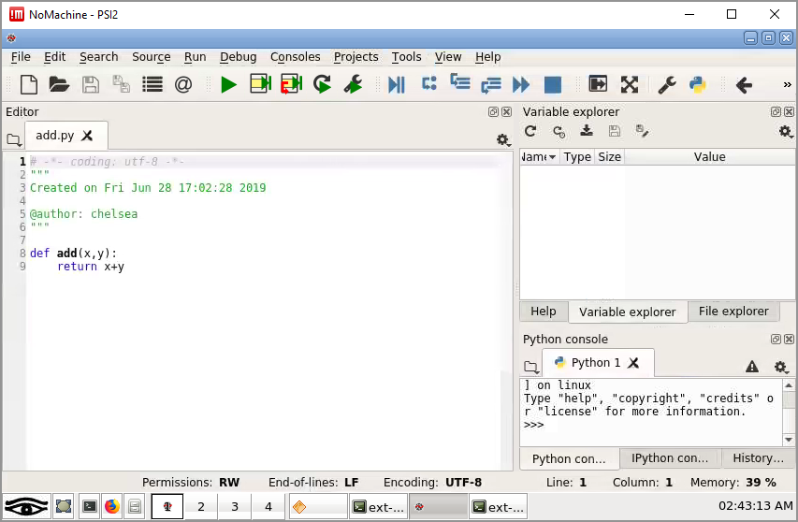
Using Spyder

Slide 39
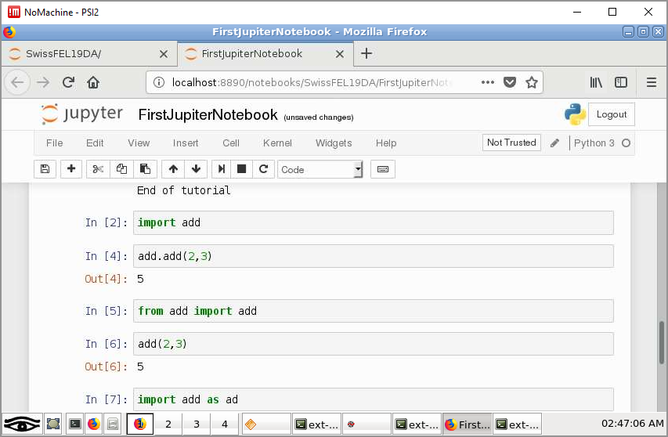
Using modules

Slide 40
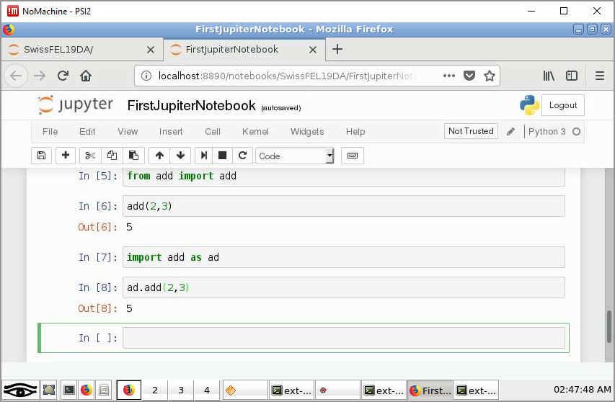
Using modules

Slide 41
Things to be aware of
Sometimes one cluster is working over others
When you log out of your no machine, make sure to close everything. Otherwise you might get a “there is already an instance of firefox running” message

